Slide 1
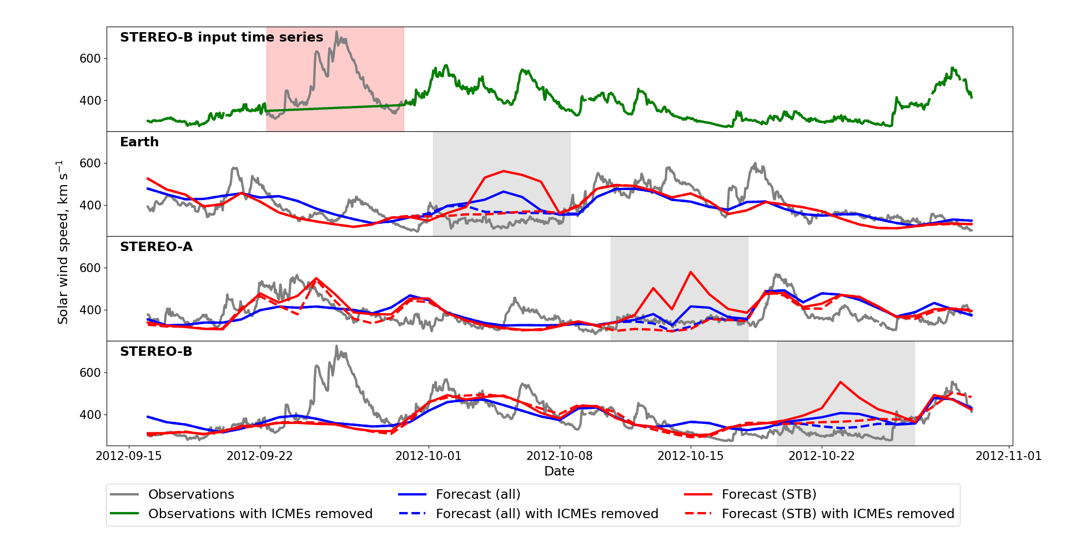
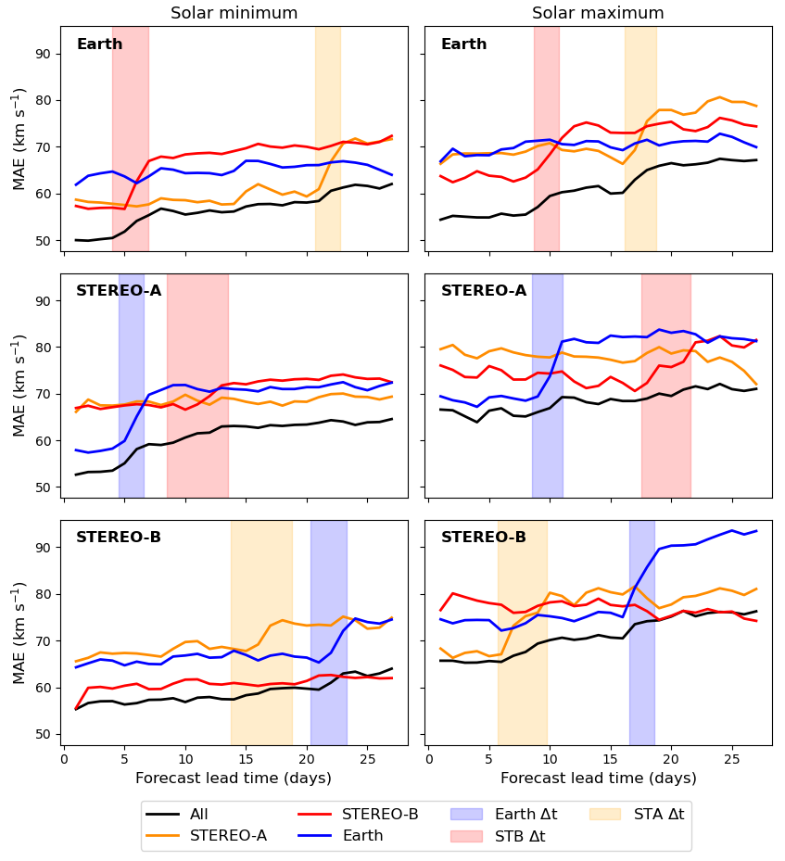
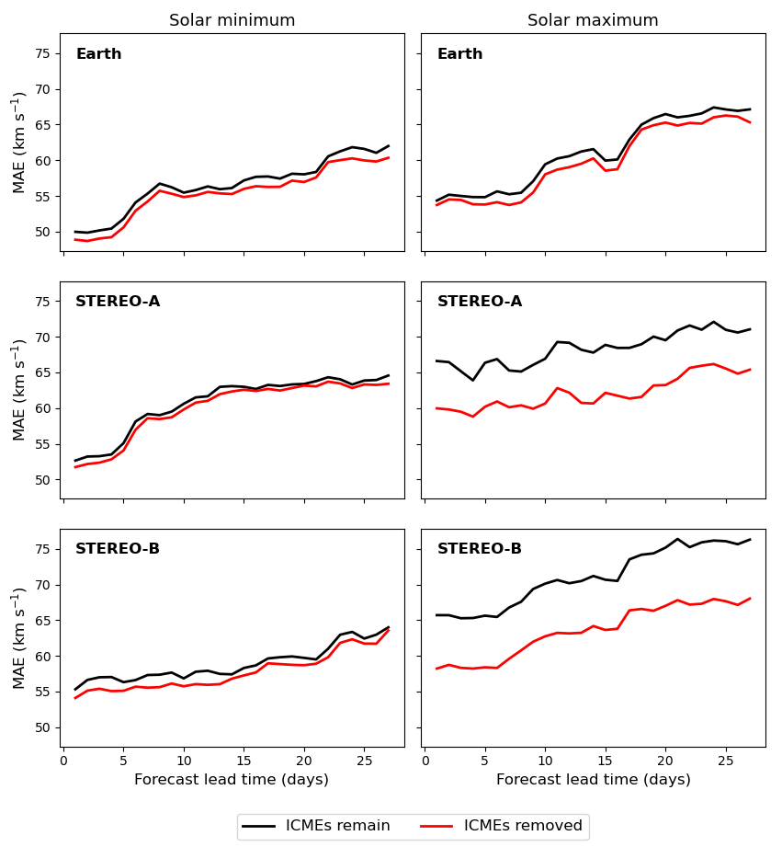
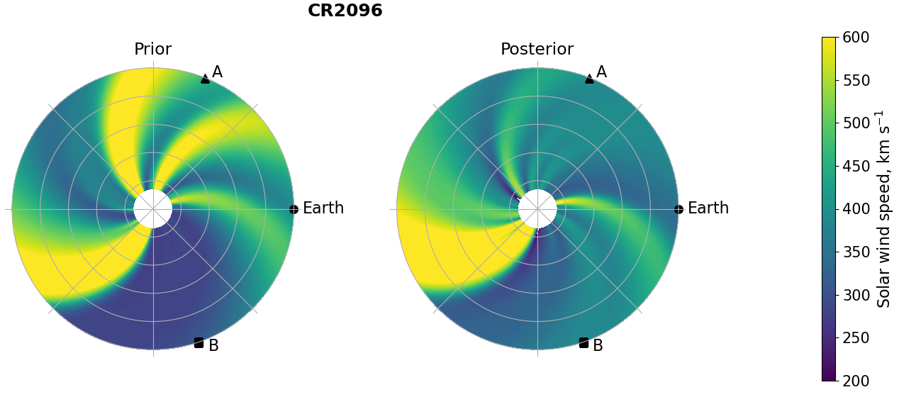
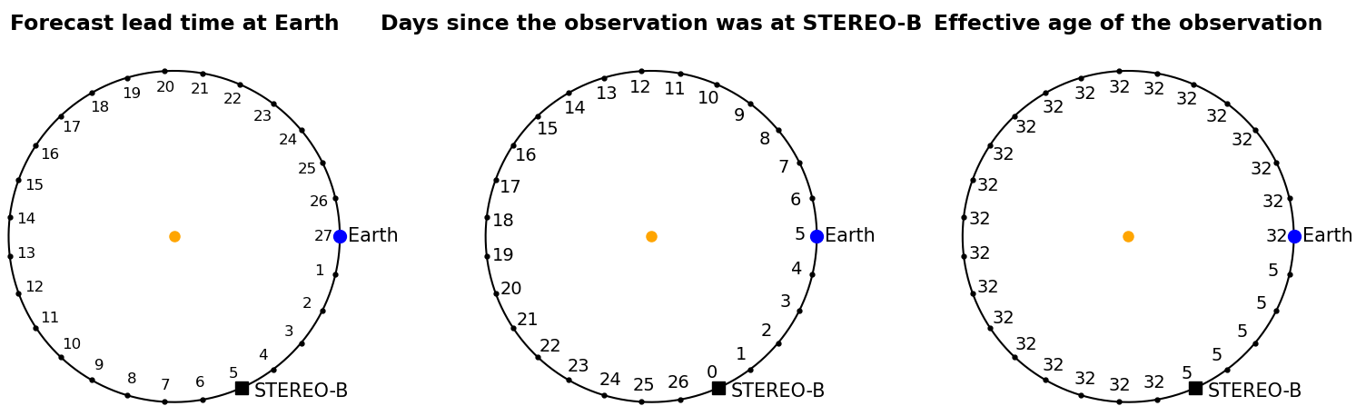
Quantifying the effect of ICME removal and observation age for in-situ solar wind data assimilation
Key points
Assimilating in-situ data from multiple spacecraft provides higher forecast skill than from any one spacecraft individually.
The age of observations, in terms of time when the required Carrington longitude was last observed, has a large effect on forecast skill.
Removing ICMEs from the assimilated time series provides a small increase in forecast skill.
Introduction
Accurate space weather forecasting needs advanced knowledge of the solar wind conditions.
Data assimilation (DA) combines model output and observations to find an optimum estimation of reality.
I am using the Burger Radius Variational Data Assimilation (BRaVDA; Lang, 2019) scheme.
Uses a solar wind model (HUX; Riley, 2011) to map observations from 1AU (STA, STB and OMNI) back to the model’s inner boundary, 30 R_{S}.
Inner boundary updated and model run forwards.
Figure 1. Solar wind solution from HUX, initialised on 22/04/2010 for Carrington Rotation 2096 (22/04/2010 to 19/05/2010). The left hand panel shows the prior state, before the DA has occurred, and the right hand panel shows the posterior state, after the DA.
Solar wind reconstructed in 27-day windows for two time periods, updated each day: 01/08/2009 to 01/02/2011 and 01/04/2012 to 01/10/2013.
BRaVDA output can be used as a forecast for the next 27 days using corotation.
Multiple spacecraft and age of observations
Experiments assimilating observations from individual spacecraft and all spacecraft.
In general, it is better to assimilate multiple observations than individual observations, even if they are not in an ideal location (Figure 2).
Figure 2. Variation of MAE (mean absolute error) with forecast lead time for experiments assimilating individual and all spacecraft for the different forecast locations (rows) for the two time periods (columns). The shaded regions show the range of corotation times for the associated spacecraft.
When assimilating individual spacecraft, there is a jump in error when forecast lead time exceeds corotation time. This can be explained by the effect age of the observation (Figure 3).
Figure 3. Schematic showing the effective age of the observations.
Removing ICMEs
BRaVDA has no knowledge of ICMEs, so if one is observed, it would be treated as a recurrent solar wind stream.
Tested with the removal of a fast ICME observed at STB.
Figure 4. Time series of STB observations and the 5-day forecast time series for the forecast locations. All observations are assimilated in blue and only STB in red.
Removing ICMEs reduces the amount of false fast streams.
Applying this to the longer time series, it is found that the improvement in solar minimum is not significant, but is greater in solar maximum due to a larger number of ICMEs
Figure 5. Variation of MAE with forecast lead time for when ICMEs remain in the observations and when they are removed.
Discussion and conclusions
It is found that assimilating observations from multiple spacecraft produces a forecast with a lower MAE than when assimilating observations from any one single spacecraft.
Stresses the value of multiple, well separated, space weather monitoring missions (e.g. L4 and L5).
The age of observations has a large effect on forecast MAE for assimilation of single spacecraft, where there is a large jump when lead time exceeds corotation time.
Removing ICMEs reduces the amount of false fast streams and has a greater effect in solar maximum.
Future work
For solar wind DA to be used operationally, it will need to work with real time data.
All experiments so far have been done using cleaned-up, science level data.
Real time data often contains erroneous results and data gaps.
I will test the performance of BRaVDA with archived real time data to see how it would work in an operational setting.
Initial results are showing that using real time data does not significantly worsen the forecasts.
References
Lang, M. & Owens, M. J. (2019). A Variational Approach to Data Assimilation in the Solar Wind. Space Weather, 17(1), 59 – 83. doi: 10.1029/2018SW001857.
Riley, P. & Lionello, R. (2011). Mapping Solar Wind Streams from the Sun to 1AU: A Comparison of Techniques. Solar Physics, 270(2), 575 – 592. doi: 10.1007/s11207-011-9766-x.
Turner, H., Owens, M.J., Lang, M., Gonzi, S. & Riley, P. (2022). Quantifying the effect of ICME removal and observation age for in situ solar wind data assimilation. Accepted in Space Weather.
Acknowledgements
I would like to thank my supervisors, Matt and Matt. Without them this work would not have been possible.
Contact information
Department of Meteorology, University of Reading, Whiteknights, RG6 6AH
Email: h.turner3@pgr.reading.ac.uk
research.reading.ac.uk/meteorology/people/harriet-turner/

